Slide 1
Fundamentals of Electric Transmission System Planning Short Course The Power System Modeling Process
Scott Dahman
PowerWorld Corporation
scott@powerworld.com
March 19-21, 2024
© copyright Scott Dahman, 2024

Slide 2
Power System Modeling Introduction
The focus for this talk is on how planning engineers model the electric grid
The words model or modeling have lots of definitions. A useful definition here is
"Modeling and simulation (M&S) is the use of a physical or logical representation of a given system to generate data and help determine decisions or make predictions about the system.”
Modeling is crucial for power system planning since we can’t (easily) physically build the system being considered
Definition source: whatis.techtarget.com/definition/modeling-and-simulation-MS

Slide 3
Modeling Cautions
"All models are wrong, but some are useful," George Box, Empirical Model-Building and Response Surfaces, (1987, p. 424)
Models are an approximation to reality, not reality, so they always have some degree of approximation
Box went on to say that the practical question is how wrong to they have to be to not be useful
A good part of engineering is deciding what is the appropriate level of modeling, and knowing under what conditions the model will fail
Always keep in mind what problem you are trying to solve!
Of course, engineering often involves using widely accepted modeling and analysis approaches for common problems. Increasingly this requires adhering to particular standards
Still, the engineer needs to know the conditions under which these approaches fail!

Slide 4
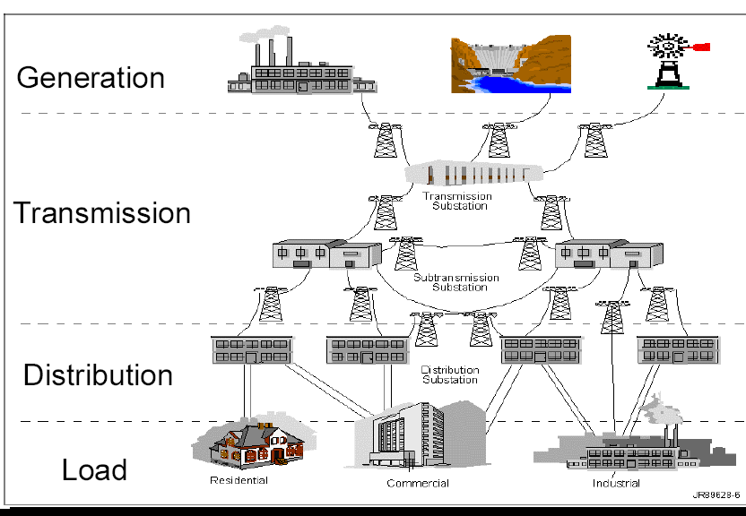

Where We’ll Start: Major Power Grid Components
The distribution system is the source of most outages, but these are almost always small-scale events
Photo source: http://save-the-squirrels.com

Slide 5
Energy and Power
Energy is A property of matter that quantifies its ability to perform useful work.
Forms: kinetic, gravitational, heat, light, sound, magnetic, nuclear, chemical, and electric
Units for energy: 1 MWh = 1000 kWh 1 kWh = 3.6 million Joules = 3412.14 Btu
Power is Energy on the move from form to form or place to place.
Time derivative of energy as it is transferred
Units for power: Watt (Volt-Ampere) kW = 1000 W, MW, GW, 1 Hp = 746 Watts
One gallon of gasoline has about 0.125 MBtu (36.5 kWh) of energy stored in chemical form
U.S. annual electric energy consumption is about 3600 billion kWh
This is about 13,333 kWh per person, which means on average we each use 1.5 kW of power continuously
Installed U.S. generation capacity is about 1000 GW (about 3 kW per person)
A rule of thumb is one pound of coal can supply about 1 kWh (details are about 13,000 btu/lb, which implies about 26.2% all in efficiency)

Slide 6
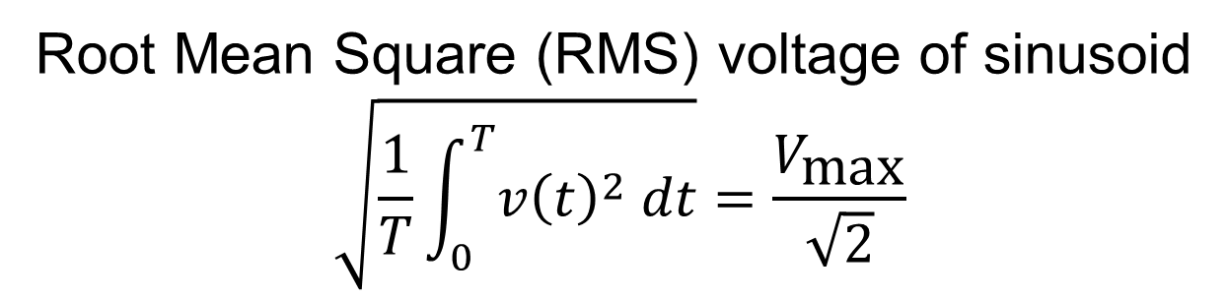
Review of phasors
The goal of phasor analysis is to simplify the analysis of constant frequency ac systems
v(t) = V_{max} cos(ωt + θ_{v})
i(t) = I_{max} cos(ωt + θ_{I})
Root Mean Square (RMS) voltage of sinusoid
$$\sqrt{\frac{1}{T}\int_{0}^{T}{v{\left(t\right)}^{2} dt}}=\frac{V_{\text{max}}}{\sqrt{2}}$$

Slide 7
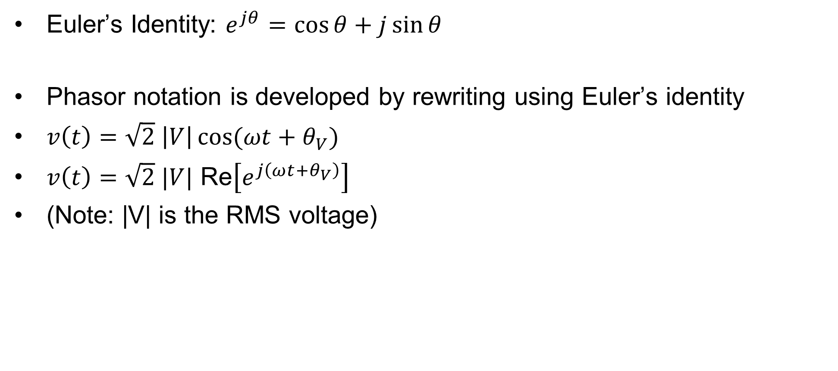
Phasor representation
Euler’s Identity: $e^{jθ}=\cos{θ}+j\sin{θ}$
Phasor notation is developed by rewriting using Euler’s identity
$v\left(t\right)=\sqrt{2} \left|V\right|\cos{(ωt+θ_{V})}$
$v\left(t\right)=\sqrt{2} |V| \text{Re}\left[e^{j\left(ωt+θ_{V}\right)}\right]$
(Note: |V| is the RMS voltage)

Slide 8
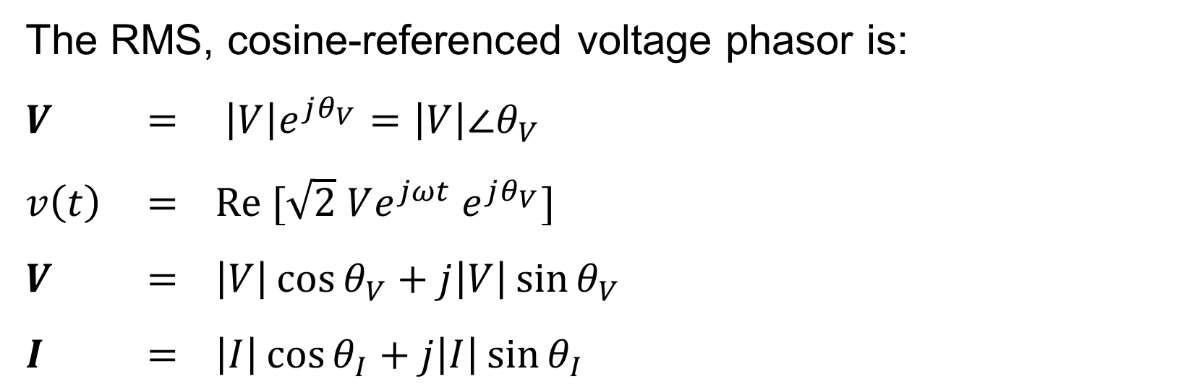
Phasor representation, cont’d
The RMS, cosine-referenced voltage phasor is:
$V$ $=$ $\left|V\right|e^{jθ_{V}}=\left|V\right|∠θ_{V}$
$v\left(t\right)$ $=$ $\text{Re} [\sqrt{2} Ve^{jωt} e^{jθ_{V}}]$
$V$ $=$ $\left|V\right|\cos{θ_{V}}+j\left|V\right|\sin{θ_{V}}$
$I$ $=$ $\left|I\right|\cos{θ_{I}}+j\left|I\right|\sin{θ_{I}}$
(Note: Some texts use boldface type for complex numbers; some use overbars)

Slide 9
Power system notation
Power system components are usually shown as
“oneline diagrams.”
This makes more sense when considering three-phase systems
Transmission lines are shown as a single line
Large arrows are
used to show loads
Generators are
shown as circles

Slide 10
Reactive compensation
Key idea of reactive compensation is to supply reactive power locally. In the previous example this can be done by adding a 16 Mvar capacitor at the load
Compensated circuit is identical to first example with just real power load
This problem was only easy to solve because the load voltage magnitude was assumed constant; in practice this is not the case and motivates the need for power flow algorithms

Slide 11
Reactive compensation, cont’d
Reactive compensation decreased the line flow from 564 Amps to 400 Amps. This has advantages
Lines losses, which are equal to I² R decrease
Lower current allows utility to use small wires, or alternatively, supply more load over the same wires
Voltage drop on the line is less
Reactive compensation is used extensively by utilities
Capacitors can be used to “correct” a load’s power factor to an arbitrary value.

Slide 12
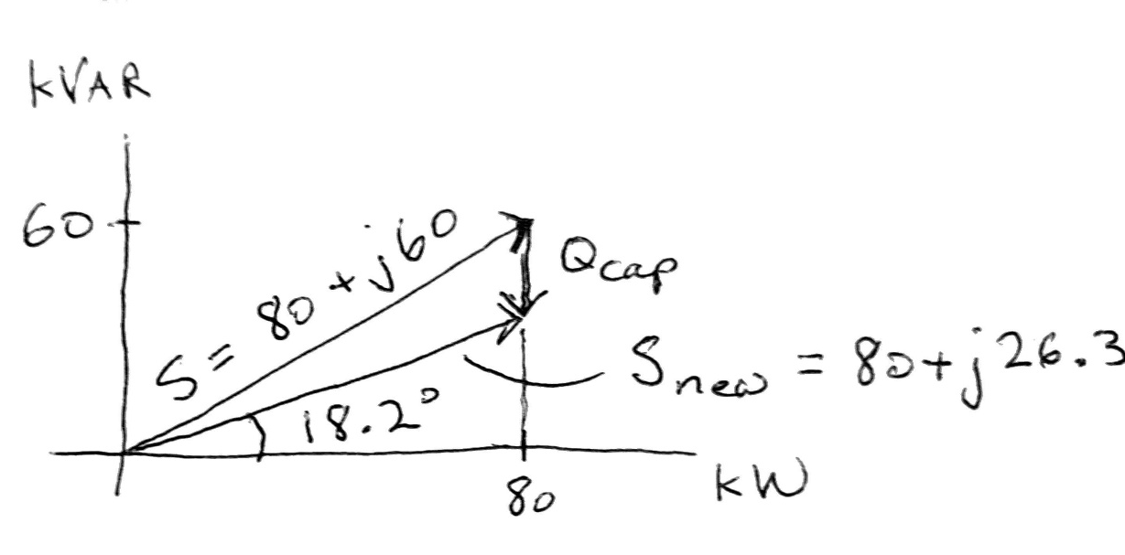
Power factor correction example

Slide 13
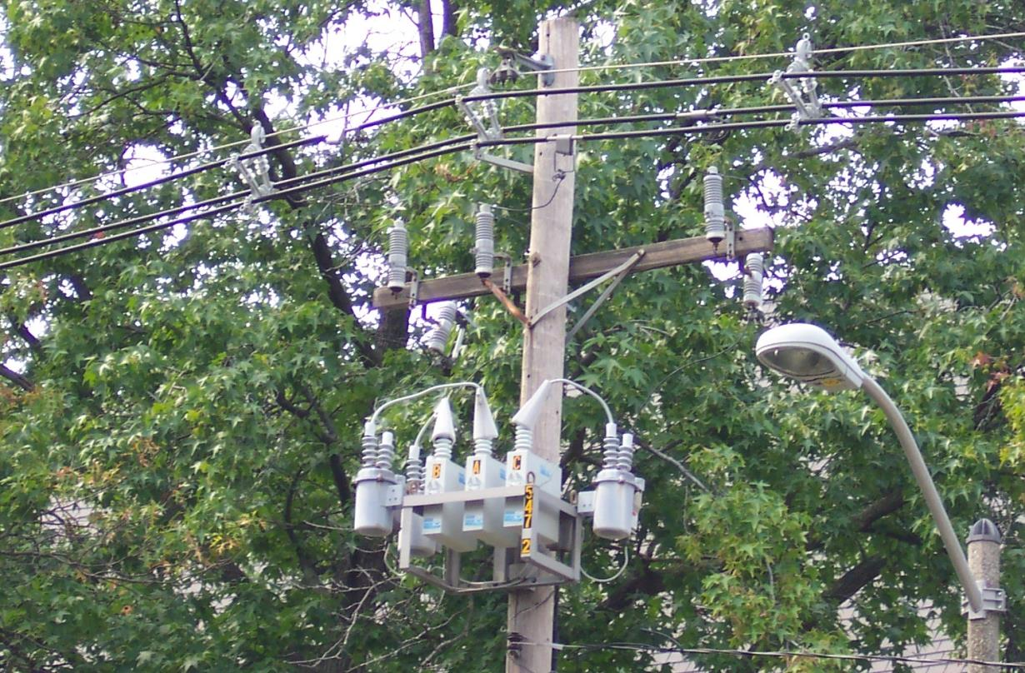
Distribution system capacitors

Slide 14
Balanced Three-Phase (φ) Systems
A balanced three-phase (φ) system has
three voltage sources with equal magnitude, but with an angle shift of 120°
equal loads on each phase
equal impedance on the lines connecting the generators to the loads
Bulk power systems are almost exclusively 3φ
Single-phase is used primarily only in low voltage, low power settings, such as residential and some commercial

Slide 15
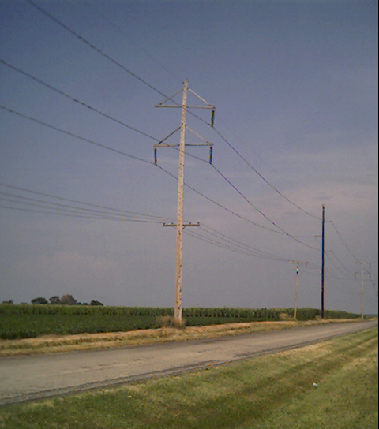
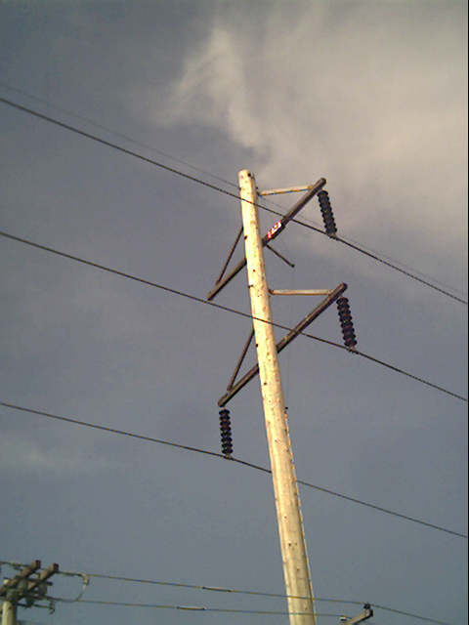
Three-Phase Transmission Line

Slide 16
Power System Models Needed for the Power Flow
The next few slides introduce the common models of the major electric grid components used for static analysis
Transmission Lines
Transformers
Generators
Loads
Remainder of this section then explains the process of assembling models of large-scale electric grids for planning studies
Power flow is covered in the next two talks

Slide 17
Transmission and Distribution
Goal is to move electric power from generation to load with low losses
Less losses at high voltages, but more difficult to insulate
Typical transmission voltages levels are (line-to-line) 765, 500, 345, 230, 161, 138, 115, 69 kV
The highest voltage in North America is 765 kV, but China has a 1000 kV grid
Lower voltages are used for distribution (12.4, 13.8 kV); Transformers used to change voltages
Typical losses are 3 to 5% in transmission and 10 to 15% in the distribution system

Slide 18
Transmission and Distribution
Transmission
networked connections
power can be supplied from multiple sources
voltage 69 kV and above
mostly overhead, with some underground in urban areas
Usually source of large-scale blackouts
Distribution
radial connections
power moves in one direction only
voltage below 69 kV
the source of most blackouts, but these are local
Most new construction is underground, especially in suburban and urban locations

Slide 19
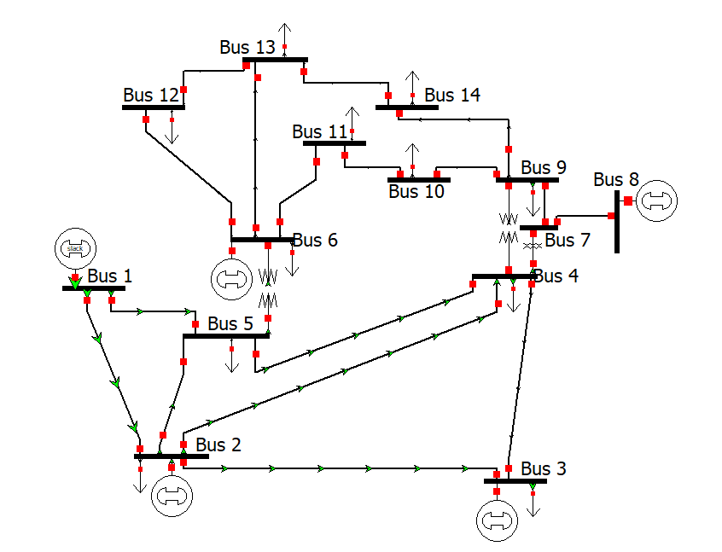
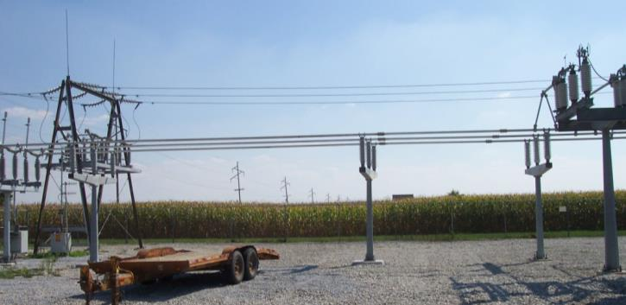
One-line Diagrams
Most high voltage power systems are modeled as balanced three-phase systems
A balanced three-phase system can be represented as a single (or one) line diagram
Onelines show the major power system components such as generators, loads, transmission lines, and transformers
Components join together at a bus
Substation bus

Slide 20
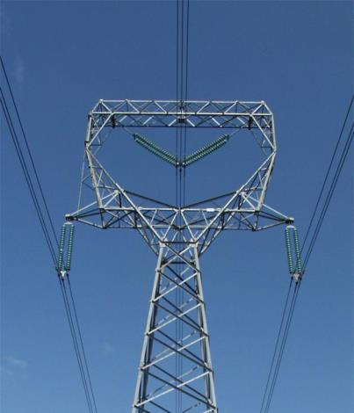
Transmission Lines
Given the short course focus on power flow, we’ll quickly go through an overview of transmission line, transformer, generator and load modeling
Our focus is on how to use the models to study power systems in tools such as power flow
Transmission lines are the primary method for long distance electric power transfer
Overhead ac
Underground ac
HVDC – overhead or underground

Slide 21
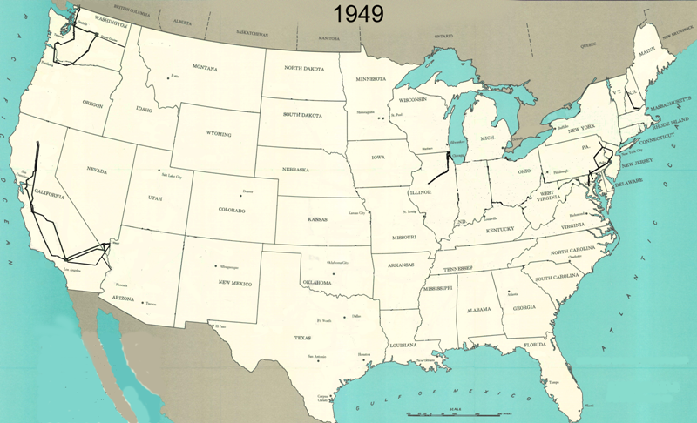
345 kV+ Transmission Growth at a Glance

Slide 22
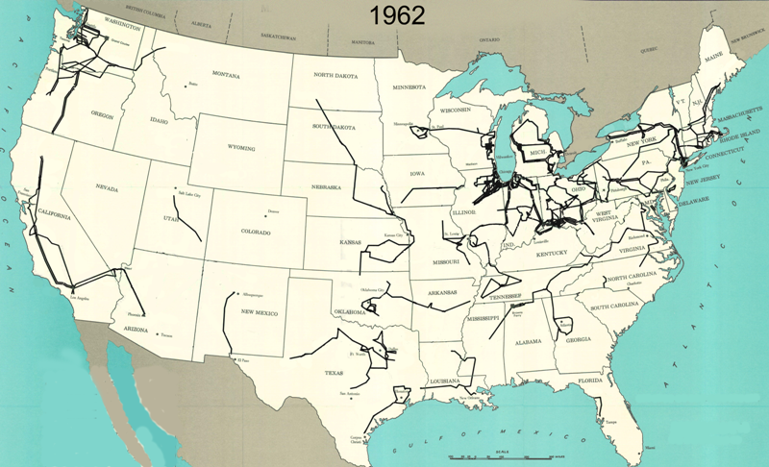
345 kV+ Transmission Growth at a Glance

Slide 23
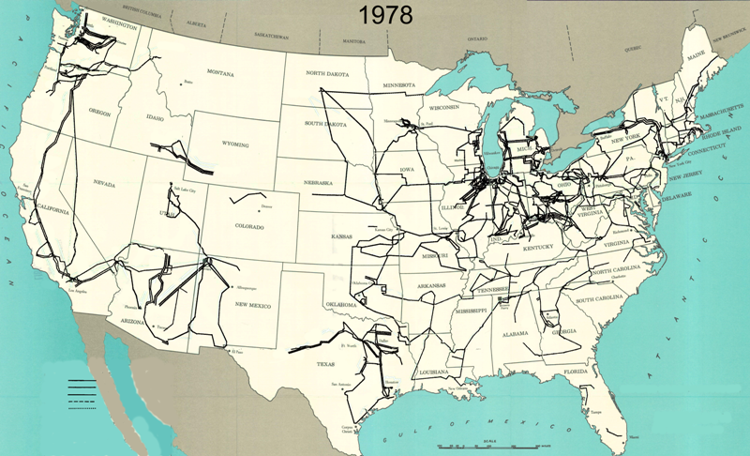
345 kV+ Transmission Growth at a Glance

Slide 24
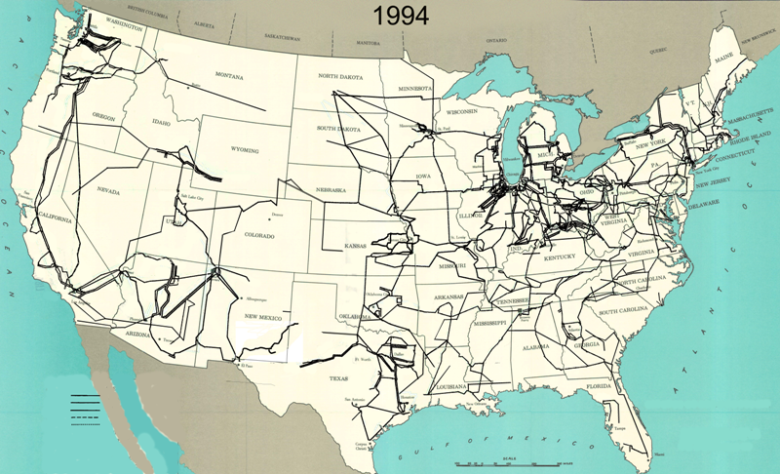
345 kV+ Transmission Growth at a Glance

Slide 25
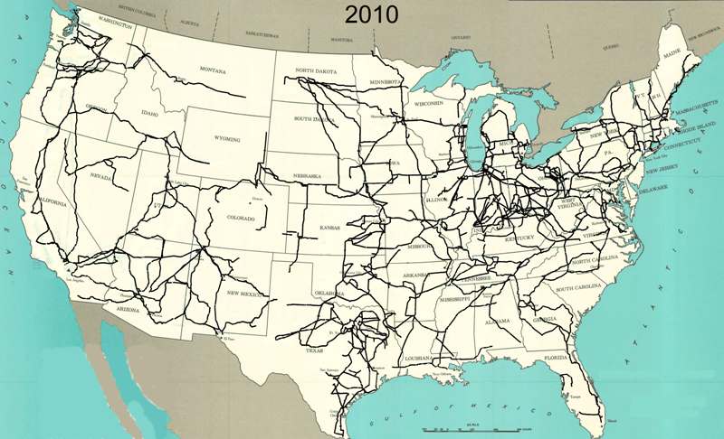
345 kV+ Transmission Growth at a Glance

Slide 26
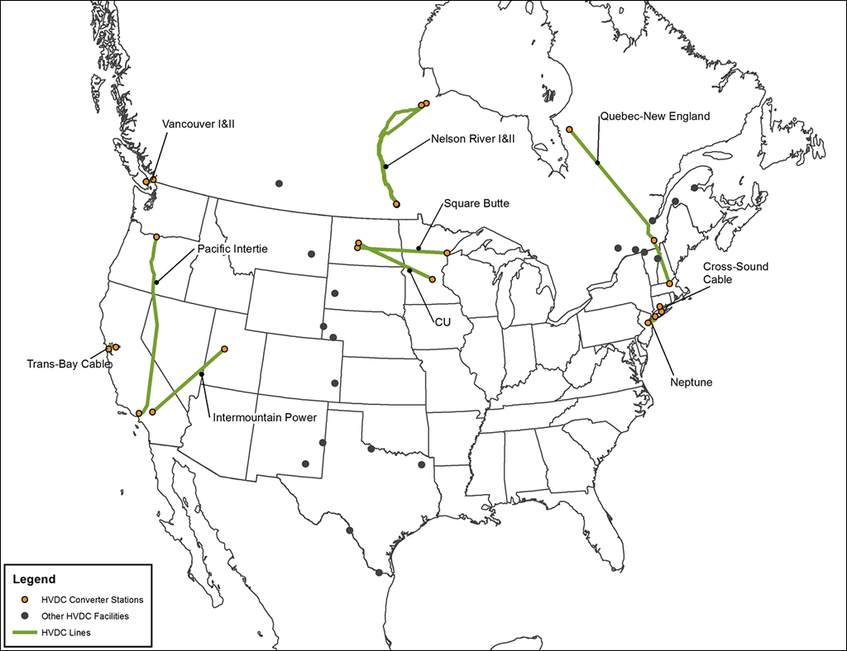
HVDC Lines in North America
http://www.grainbeltexpresscleanline.com/site/page/history_of_hvdc_transmission

Slide 27
Line Conductors
Typical transmission lines use multi-strand conductors
ACSR (aluminum conductor steel reinforced) conductors are most common. A typical Al to steel ratio is about 4 to 1.
AAC (all aluminum conductors) are lighter but have less strength; used in urban areas with shorter spans
Copper is heavier, but has better conductance; used in cables where weight is not an issue
Total conductor area is given in circular mils. One circular mil is the area of a circle with a diameter of 0.001 = π × 0.0005² square inches
Because conductors are stranded, the equivalent radius must be provided by the manufacturer. In tables this value is known as the geometric mean radius (GMR) and is usually expressed in feet.

Slide 28
Transmission Line Parameters
We'll quickly cover how to calculate transmission line parameters, which will then form part of the input to our power system model, such as in PowerWorld:
Resistance
Inductance
Capacitance
Ampacity

Slide 29
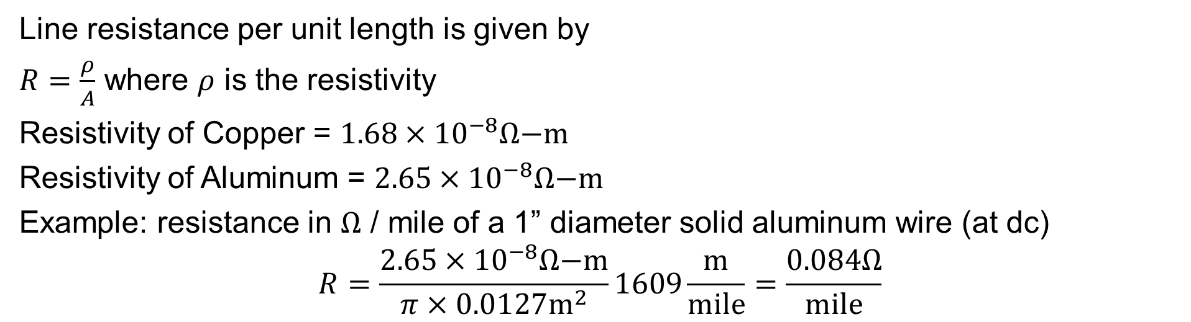
Line Resistance
Line resistance per unit length is given by
$R=\frac{ρ}{A}$ where $ρ$ is the resistivity
Resistivity of Copper = $1.68×{10}^{−8}Ω\text{−}\text{m}$
Resistivity of Aluminum = $2.65×{10}^{−8}Ω\text{−}\text{m}$
Example: resistance in $Ω$ / mile of a 1” diameter solid aluminum wire (at dc)
$$R=\frac{2.65×{10}^{−8}Ω\text{−}\text{m}}{π×0.0127{\text{m}}^{2}}1609\frac{\text{m}}{\text{mile}}=\frac{0.084Ω}{\text{mile}}$$
Because ac current tends to flow towards the surface of a conductor, the resistance of a line at 60 Hz is slightly higher than at dc; resistivity and hence line resistance change with conductor temperature (change is about 0.4% per degree C)
Because ACSR conductors are stranded, actual resistance, inductance and capacitance needs to be determined from tables.

Slide 30
Recall, Power System Components
Major Components:
Generators
Power conversion technology, regulation and control
Transmission System (69 kV and above)
Substations, transmission lines, power transformers, control devices
Distribution System (below 69 kV)
Distribution feeders, service transformers, metering and control
Loads
Customer electricity demands, patterns, quality

Slide 31
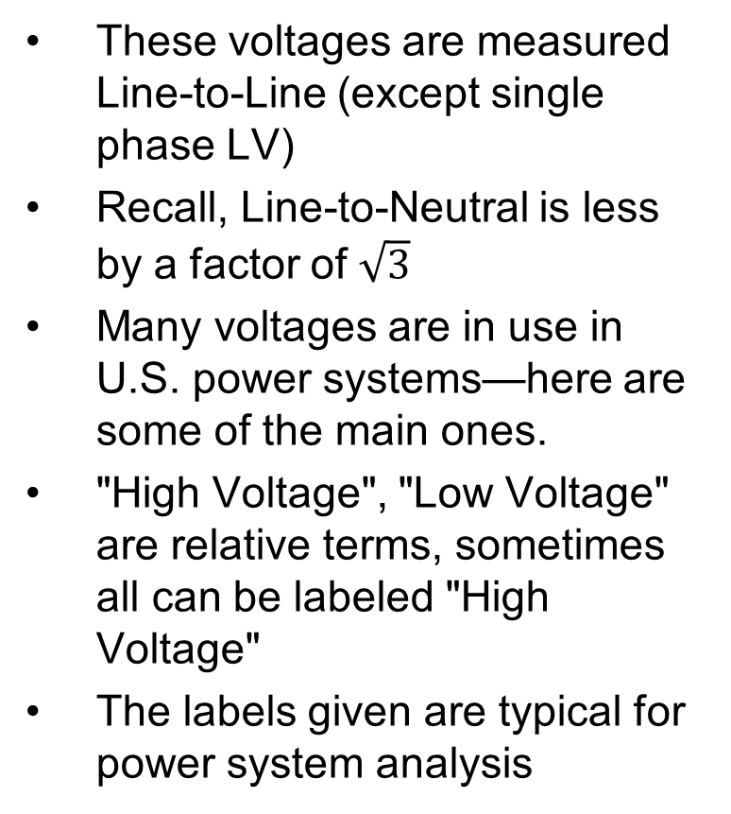
Voltage Levels Usage Table
These voltages are measured Line-to-Line (except single phase LV)
Recall, Line-to-Neutral is less by a factor of $\sqrt{3}$
Many voltages are in use in U.S. power systems—here are some of the main ones.
"High Voltage", "Low Voltage" are relative terms, sometimes all can be labeled "High Voltage"
The labels given are typical for power system analysis
Level | Typical Voltages | Usage
Low Voltage | 120 V, 208 V, 240 V, 600 V | Customer-level loads, residential, commercial, smaller industrial
Medium Voltage | 4.16 kV, 12.47 kV, 13.8 kV, 20 kV, 22 kV, 34.5 kV | Distribution feeders, generator step-up, larger industrial motors
High Voltage | 69 kV, 100 kV, 115 kV, 138 kV, 161 kV, 230 kV | Transmission system network
Extra High Voltage (EHV) | 345 kV, 500 kV, 765 kV | Backbone of large transmission systems

Slide 32
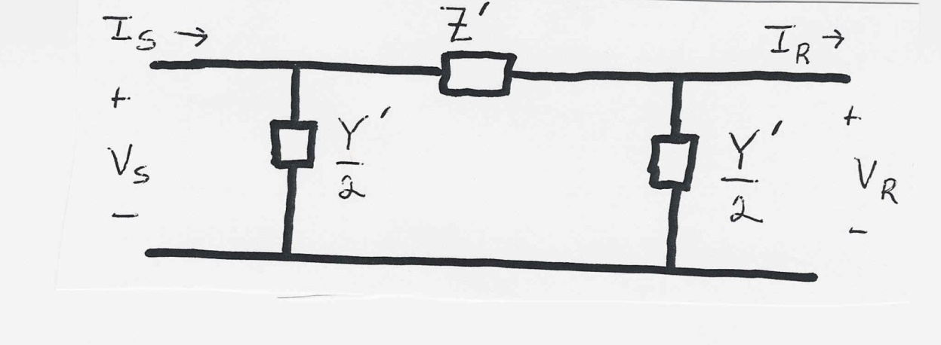
Transmission Line Models
Transmission lines will be modeled using the π circuit
This model is only valid for transmission lines with symmetric tower configurations or if one assumes uniformly transposed lines

Slide 33
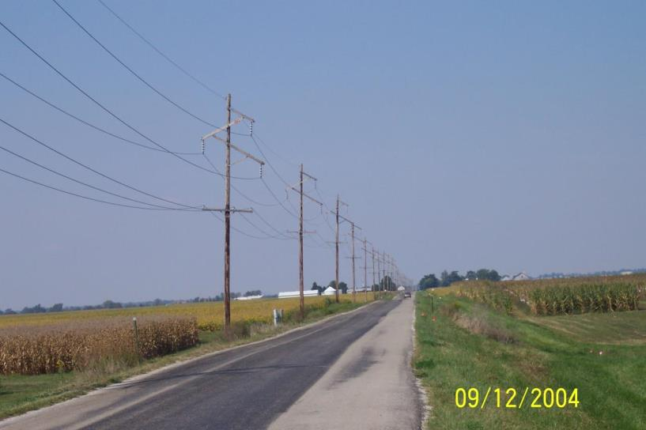
Symmetric Line Spacing – 69 kV

Slide 34

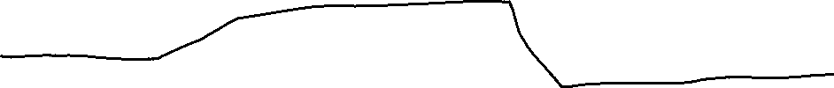
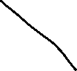
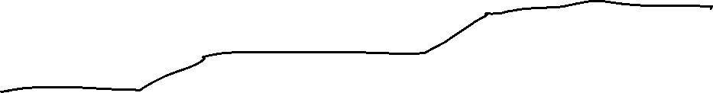
Transposition
To keep system balanced, over the length of a transmission line the conductors are rotated so each phase occupies each position on tower for an equal distance. This is known as transposition.
In practice, not all lines are transposed, but it is a very common assumption for simplicity of calculation
Aerial or side view of conductor positions over the length of the transmission line.

Slide 35
Conductor Bundling
To increase the capacity of high voltage transmission lines it is very common to use a number of conductors per phase. This is known as conductor bundling. Typical values are two conductors for 345 kV lines, three for 500 kV and four for 765 kV.

Slide 36
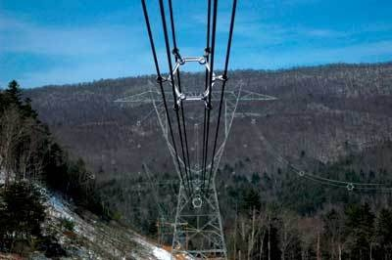
Bundled Conductor Pictures
The AEP Wyoming-Jackson Ferry 765 kV line uses 6-bundle conductors. Conductors in a bundle are at the same voltage!
Photo Source: BPA and American Electric Power

Slide 37
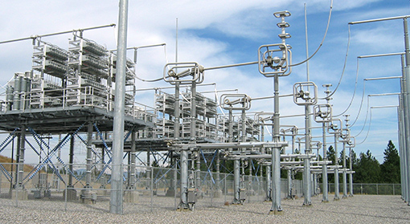
Transmission Line Series Compensation
One way to increase the transmission capacity of a transmission line that is limited by its reactance is to add series compensation
Capacitors are placed in series with the transmission line (covered in Example 5.10)
Image shows BPA series capacitors in a 500 kV line
Image: https://www.bpa.gov/news/newsroom/Pages/Chief-engineers-reunite-reminisce-for-BPAs-75th.aspx

Slide 38
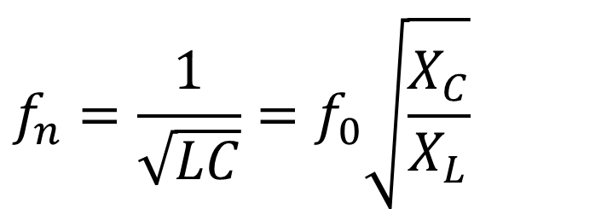
Transmission Line Series Compensation
Amount of series compensation is expressed as a percentage of the total line reactance (e.g., 50%)
The series capacitance is usually setup so that it can be bypassed sometimes
There can be excessive reactive power generation on the system during light loads, like at night
There can be a concern with sub-synchronous interactions (SSI)
$$f_{n}=\frac{1}{\sqrt{LC}}=f_{0}\sqrt{\frac{X_{C}}{X_{L}}}$$

Slide 39
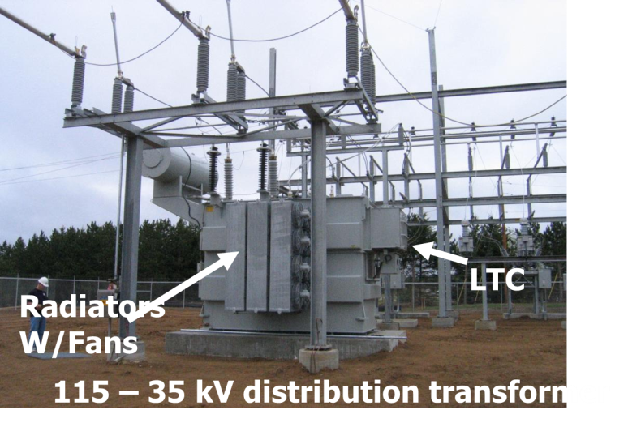
Transformers Overview
Power systems are characterized by many different voltage levels, ranging from 765 kV down to 240/120 volts.
Transformers are used to transfer power between different voltage levels.
The ability to inexpensively change voltage levels is a key advantage of ac systems over dc systems.
In this section we’ll development models for the transformer and discuss various ways of connecting three phase transformers.

Slide 40
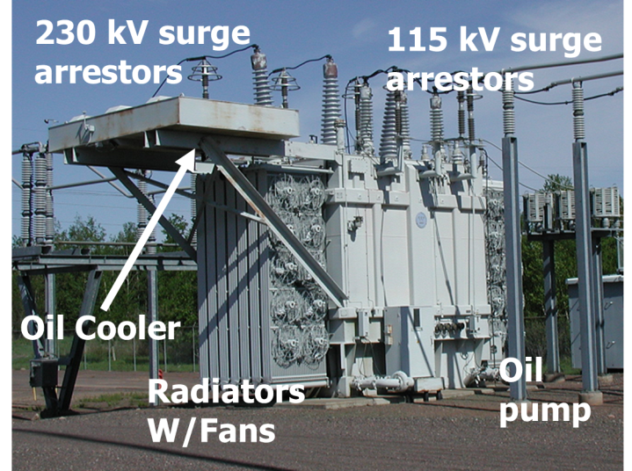
Transmission Level Transformer

Slide 41
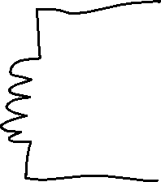

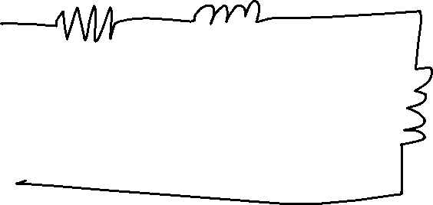
Simplified Equivalent Circuit
Often the shunt elements are assumed to have such high impedance that they are ignored

Slide 42
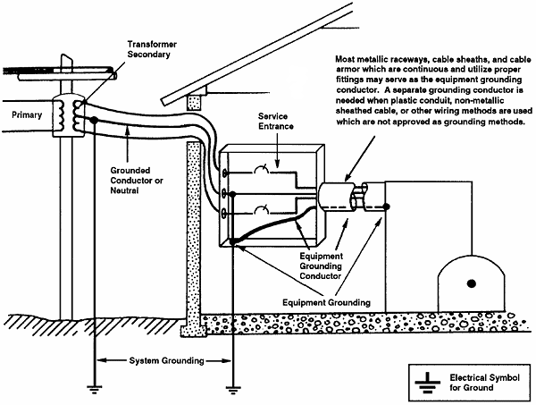

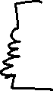
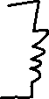


Residential Distribution Transformers
Single phase transformers are commonly used in residential distribution systems. Most distribution systems are 4 wire, with a multi-grounded, common neutral.
Image: www.osha.gov/dte/library/electrical/electrical_10.gif

Slide 43
How Do We Deal with Transformers On a Large System?
With many transformers, the equations of the form v1=a*v2 would be everywhere
The per-unit system was designed to make hand calculations and early computer calculations easier.
Divide all numerical values by a "base" value, i.e. normalize them
Instead of voltages in V, currents in A, impedance in Ohms, all are given in per-unit.
Ideal transformers go away in the per-unit system
Per-unit system has other advantages as well, and is extremely common in industry

Slide 44
Per Unit Calculations
A key problem in analyzing power systems is the large number of transformers.
It would be very difficult to continually have to refer impedances to the different sides of the transformers
This problem is avoided by a normalization of all variables.
This normalization is known as per unit analysis.

Slide 45
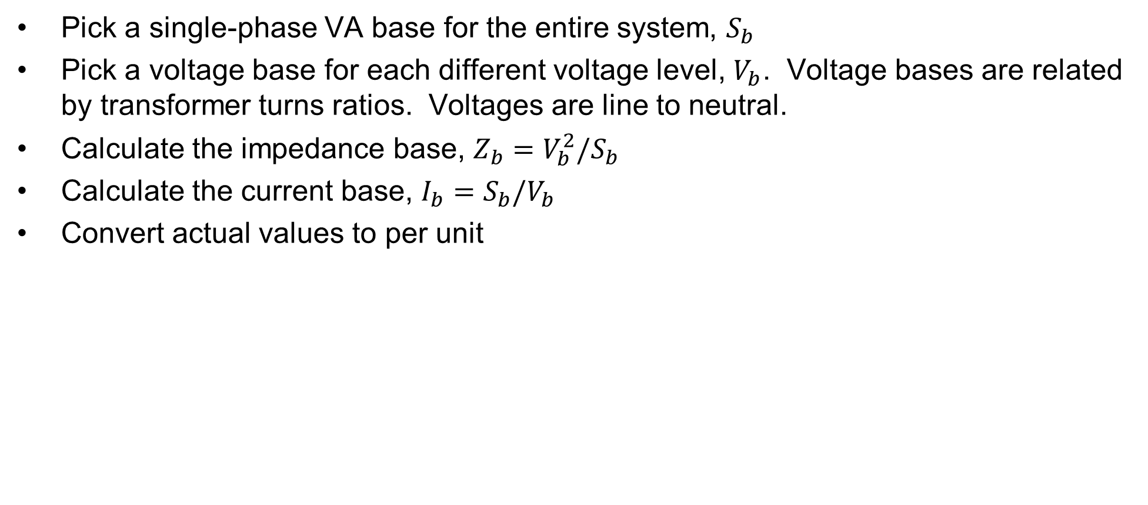
Per Unit Conversion Procedure, Single-Phase
Pick a single-phase VA base for the entire system, $S_{b}$
Pick a voltage base for each different voltage level, $V_{b}$. Voltage bases are related by transformer turns ratios. Voltages are line to neutral.
Calculate the impedance base, $Z_{b}=V_{b}^{2}/S_{b}$
Calculate the current base, $I_{b}=S_{b}/V_{b}$
Convert actual values to per unit
Note, per unit conversion on affects magnitudes, not
the angles. Also, per unit quantities no longer have
units (i.e., a voltage is 1.0 p.u., not 1 p.u. volts)

Slide 46
Per Unit Solution Procedure
Convert to per unit (p.u.) (many problems are already in per unit)
Solve
Convert back to actual as necessary

Slide 47




Per Unit Example
Solve for the current, load voltage and load power in the circuit shown below using per unit analysis with an S_{B} of 100 MVA, and voltage bases of 8 kV, 80 kV and 16 kV.
Original Circuit

Slide 48



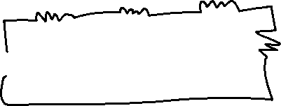
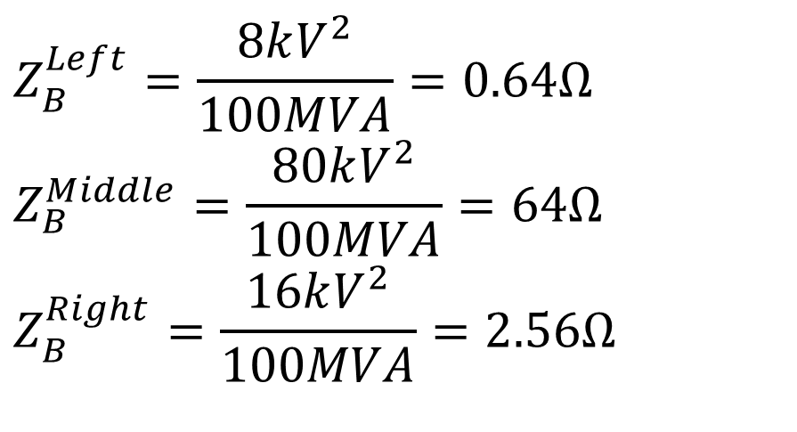

Per Unit Example, cont’d
$$Z_{B}^{Left}=\frac{8kV^{2}}{100MVA}=0.64Ω \\ Z_{B}^{Middle}=\frac{80kV^{2}}{100MVA}=64Ω \\ Z_{B}^{Right}=\frac{16kV^{2}}{100MVA}=2.56Ω$$
Same circuit, with
values expressed
in per unit.

Slide 49
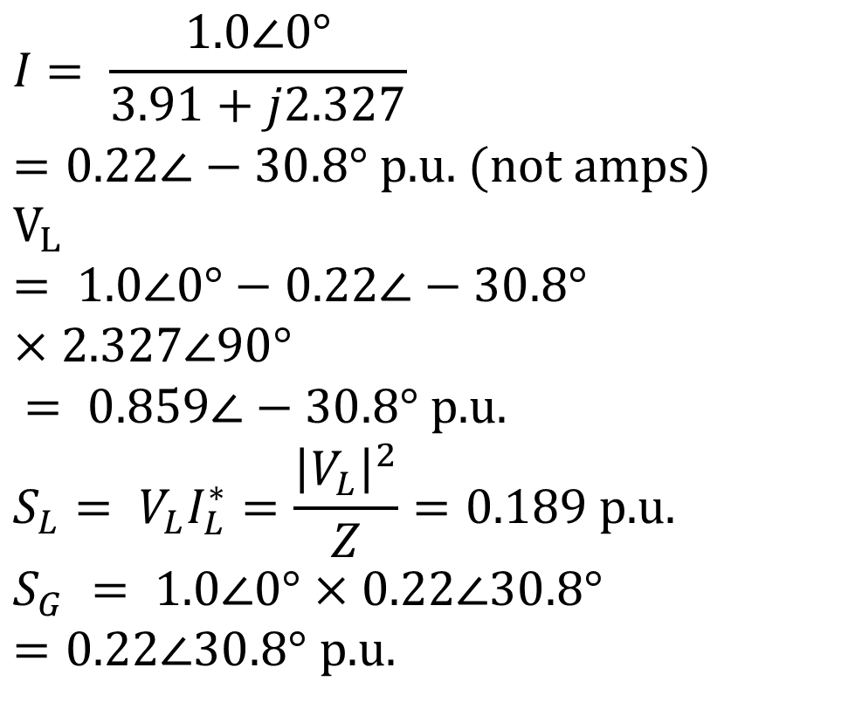
Per Unit Example, Cont’d
$$I = \frac{1.0∠0°}{3.91+j2.327}=0.22∠−30.8° \text{p}\text{.}\text{u}\text{. }(\text{not} \text{amps}) \\ V_{L} = 1.0∠0°−0.22∠−30.8°×2.327∠90° \\ = 0.859∠−30.8° \text{p}\text{.}\text{u}\text{.} \\ S_{L}= V_{L}I_{L}^{∗}=\frac{{\left|V_{L}\right|}^{2}}{Z}=0.189 \text{p}\text{.}\text{u}\text{.} \\ S_{G} = 1.0∠0°×0.22∠30.8°=0.22∠30.8° \text{p}\text{.}\text{u}\text{.}$$

Slide 50
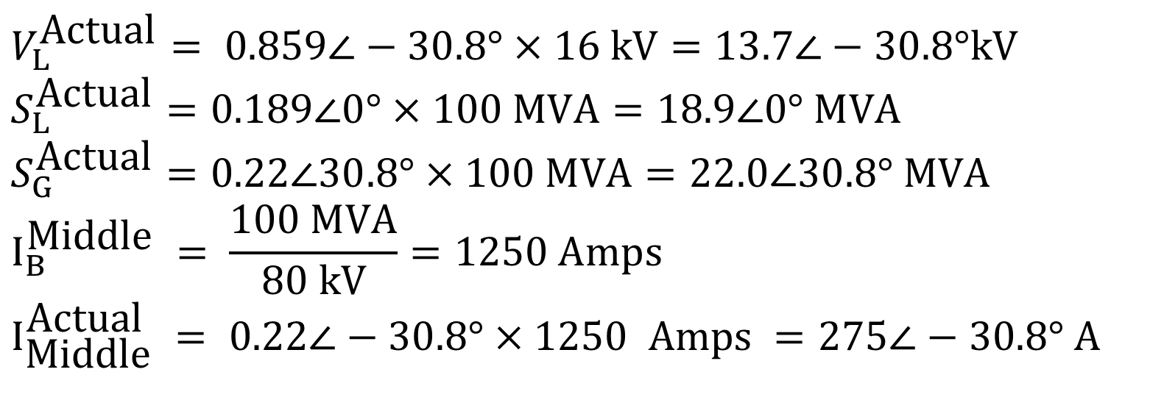
Per Unit Example, cont’d
To convert back to actual values just multiply the
per unit values by their per unit base
$$V_{L}^{\text{Actual}}= 0.859∠−30.8°×\text{16 }\text{kV}=13.7∠−30.8°\text{kV} \\ S_{L}^{\text{Actual}}=0.189∠0°×100 \text{MVA}=18.9∠0° \text{MVA} \\ S_{G}^{\text{Actual}}=0.22∠30.8°×100 \text{MVA}=22.0∠30.8° \text{MVA} \\ I_{B}^{\text{Middle}} = \frac{100 \text{MVA}}{\text{80 }\text{kV}}=1250 \text{Amps} \\ I_{\text{Middle}}^{\text{Actual}} = 0.22∠−30.8°×1250 \text{Amps} =275∠−30.8° Α$$

Slide 51
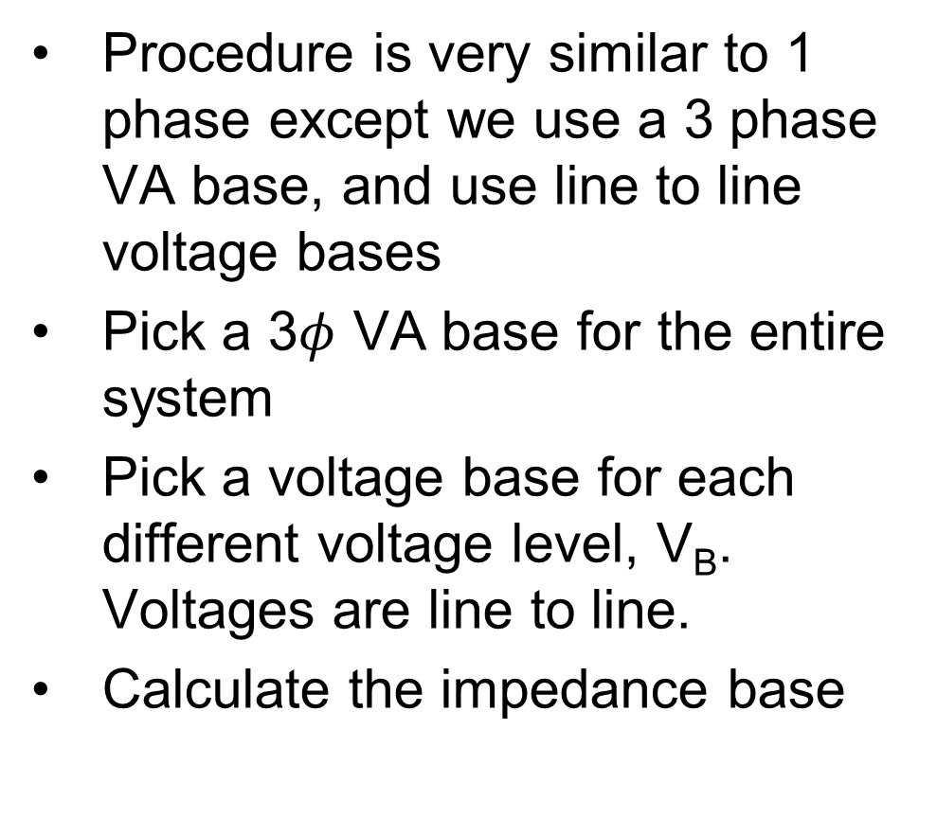
Three Phase Per-Unit
Procedure is very similar to 1 phase except we use a 3 phase VA base, and use line to line voltage bases
Pick a 3$φ$ VA base for the entire system
Pick a voltage base for each different voltage level, V_{B}. Voltages are line to line.
Calculate the impedance base
Exactly the same impedance bases as with single phase!

Slide 52
Three Phase Per-Unit, cont'd
Calculate the current base, IB
Convert actual values to per unit
Exactly the same current bases as with single phase!
But, be careful in using 3ph bases to calculate it (need a root 3)

Slide 53
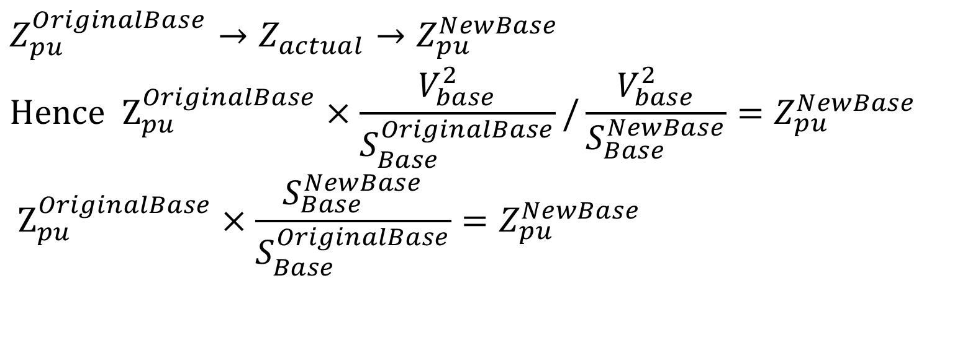
Per Unit Change of MVA Base
Parameters for equipment are often given using power rating of equipment as the MVA base
To analyze a system all per unit data must be on a common power base
$$Z_{pu}^{OriginalBase}→Z_{actual}→Z_{pu}^{NewBase} \\ \text{Hence} {\text{Z}}_{pu}^{OriginalBase}×\frac{V_{base}^{2}}{S_{Base}^{OriginalBase}}/\frac{V_{base}^{2}}{S_{Base}^{NewBase}}=Z_{pu}^{NewBase} \\ {\text{Z}}_{pu}^{OriginalBase}×\frac{S_{Base}^{NewBase}}{S_{Base}^{OriginalBase}}=Z_{pu}^{NewBase}$$

Slide 54
Per Unit Change of Base Example
A 54 MVA transformer has a leakage reactance of 3.69%. What is the reactance on a 100 MVA base?

Slide 55
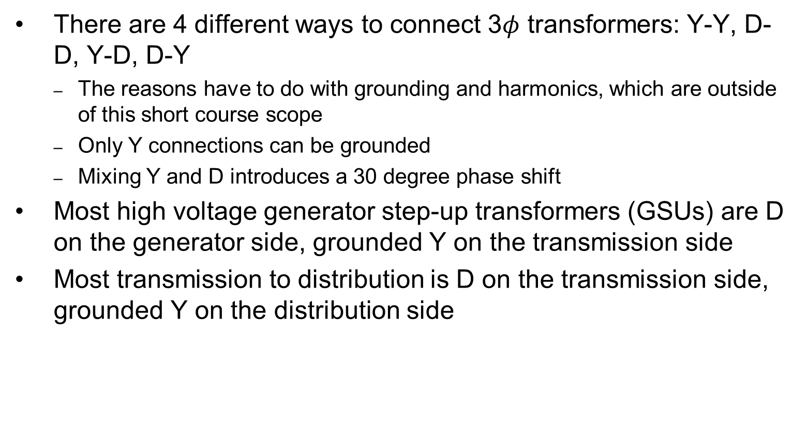
Three Phase Transformers
There are 4 different ways to connect 3$φ$ transformers: Y-Y, D-D, Y-D, D-Y
The reasons have to do with grounding and harmonics, which are outside of this short course scope
Only Y connections can be grounded
Mixing Y and D introduces a 30 degree phase shift
Most high voltage generator step-up transformers (GSUs) are D on the generator side, grounded Y on the transmission side
Most transmission to distribution is D on the transmission side, grounded Y on the distribution side

Slide 56
Autotransformers
Autotransformers are transformers in which the primary and secondary windings are coupled magnetically and electrically.
This results in lower cost, and smaller size and weight.
Most transmission level transformers are autotransformers, connected Y-Y with the low side grounded
The key disadvantage is loss of electrical isolation between the voltage levels; not used when a is large. For example in stepping down 7160/240 V we do not ever want 7160 on the low side!

Slide 57
Three Winding Transformers
Many high voltage transformers have a third winding, called the tertiary winding; called three winding transformers
There are a number of benefits in having 3 windings
Tertiary can be used to provide lower voltage electric service, including providing substation service for remote transmission substations; sometimes capacitors are connected to the tertiary
Helps with fault protection by reducing the zero sequence current providing higher zero sequence currents (beyond short course scope)
When D-connected helps to reduce unbalanced and third harmonic issues (again beyond short course scope)

Slide 58
Load Tap-Changing Transformers
LTC transformers have tap ratios that can be varied to regulate bus voltages
Sometimes called on-load tap-changing transformers (OLTCs) or under-load tap-changing transformers (ULTCs)
The typical range of variation is ±10% from the nominal values, usually in 33 discrete steps (0.0625% per step).
Because tap changing is a mechanical process, LTC transformers usually have a time delay deadband to avoid repeated changes (e.g., 30 seconds)
Unbalanced tap positions can cause “circulating vars”

Slide 59
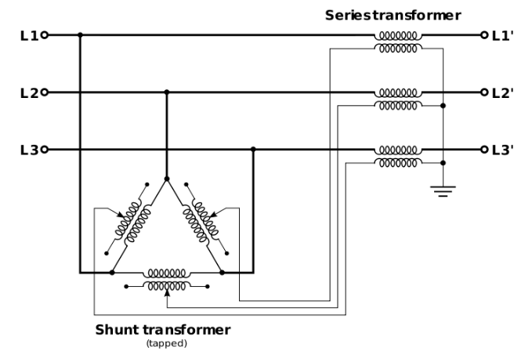
Phase Shifting Transformers
Phase shifting transformers are used to control the phase angle across the transformer
Also called phase angle regulators (PARs) or quadrature booster transformers (British usage)
Since power flow through the transformer depends upon phase angle, this allows the transformer to regulate the power flow through the transformer
Phase shifters can be used to prevent inadvertent "loop flow" and to prevent line overloads.
Image Source: en.wikipedia.org/wiki/Quadrature_booster#/media/File:Qb-3ph.svg

Slide 60
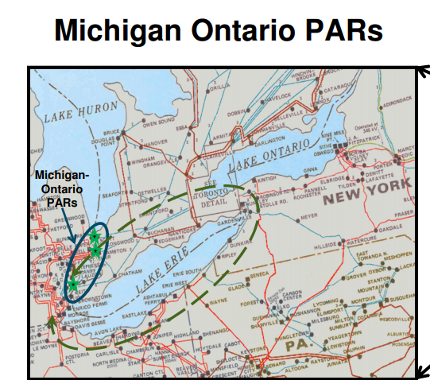
Phase Shifter Example: Lake Erie Loop Flow
There are five phase shifters (called phase angle regulators [PARs] here) at the border between Michigan and Ontario. They are used to control how much electricity travels between the US and Canada
By adjusting the PARs the flow of electricity that “loops” around Lake Erie can be controlled
Source: MISO Board of Directors Market Committee Update, 9/30/13

Slide 61
Modeling Generators and Loads for Power Flow
Generators
Engineering models depend upon application
Generators are usually synchronous machines
For generators we will use two different models:
a short term model treating the generator as a constant voltage source behind a possibly time-varying reactance
a steady-state model, treating the generator as a constant power source operating at a fixed voltage; this model will be used for power flow and economic analysis
Loads
Ultimate goal is to supply loads with electricity at constant frequency and voltage
Electrical characteristics of individual loads matter, but usually they can only be estimated
Actual loads are constantly changing, consisting of a large number of individual devices
Only limited network observability of load characteristics
Aggregate models are typically used for analysis
Two common models
Constant power: S_{i} = P_{i} + jQ_{i}
Constant impedance: S_{i} = |V|² / Z_{i}

Slide 62
Questions?

